Slide 1
Product Management Case
By Eka N. Solicha

Slide 2
Case 1
Jamie is an advanced user on a simulated digital asset trading platform. The platform allows trading using a calculated Trading Limit, which reflects the total value the user can allocate toward purchasing assets. The Trading Limit is calculated as: Trading Limit = Cash + T0 + T1 + T2 Where:T0 = Total Sell - Total Buy – Fees Fees = 0.2% × (Total Buy + Total Sell)
Given Data:
Cash: Rp40.000.000
Total Buy: Rp27.000.000
Total Sell: Rp20.500.000
T1: -Rp10.000.000
T2: Rp7.750.000

Slide 3
Answer of Case 1
Step 1 -> Calculate Fees Fees = 0.2% x (Total Buy + Total Sell)
Fees = 0.002 × (27.000.000 + 20.500.000) = 0.002 × 47.500.000 = Rp95.000
Step 2 -> Calculate T0 by Inputting Result Fees T0 = Total Sell - Total Buy - Fees
T0 = 20.500.000 − 27.000.000 − 95.000 = − 6.595.000
Step 3 -> Calculate Trading Limit by Inputting Result T0 Trading Limit = Cash + T0 + T1 + T2
Trading Limit = 40.000.000 + (−6.595.000) + (−10.000.000) + 7.750.000
Trading Limit of Jamie = Rp31.155.000

Slide 4
Case 2
Taylor is using a simulated digital asset trading platform. She notices a discrepancy between the expected Trading Limit and the value shown on the platform. Based on her calculations, the Trading Limit should be Rp7.450.000, but the platform displays only Rp2.900.000.Taylor double-checked her data:
Cash Top-Ups (3x): First: Rp8.750.000 Second: Rp6.200.000 Third: Rp4.000.000 Total Cash: Rp18.950.000 (confirmed after top-ups) Total Buy: Rp19.600.000 Total Sell: Rp15.300.000 Fees: 0.2% of (Total Buy + Total Sell) T1: -Rp9.800.000T2: Rp8.300.000
Formula Reminder: Trading Limit = Cash + T0 + T1 + T2, whereT0 = Total Sell - Total Buy - Fees

Slide 5
Answer of Case 2
Step-by-Step Recalculation:
1. Calculate Fees
Fees = 0.002 × (19.600.000 + 15.300.000) = 0.002 × 34.900.000 = Rp69.800
2. Calculate T0
T0 = 15.300.000 − 19.600.000 − 69.800 = −4.369.800
3. Recalculate Trading Limit
Trading Limit = 18.950.000 + (−4.369.800) + (−9.800.000) + 8.300.000 = Rp13.080.200

Slide 6
Answer of Case 2 (continue)
Taylor expected a Trading Limit of Rp7.450.000. The platform shows Rp2.900.000. From the calculation, the actual Trading Limit should be Rp13.080.200.
Potential root cause of the issue:
Unposted or pending transactions (e.g., buy orders not yet settled)
Temporary hold or reserve funds (e.g., security deposits or in-process withdrawals)
Calculation mismatch (platform might use real-time or stricter fee multipliers, rounding, or other buffers)
Delayed top-up posting
System error, mismatch calculation or data sync issue
Tier limit
Further investigation can entail several steps such as:
1. Check the transactions log for any pending or unposted transactions. 2. Check hold-on cast automatically triggered by the system to investigate any temporary hold or reserve funds 3. Check the calculcation system of the trading fee whether it is based on the live or a buffered rate
4. Check if all of the top up already marked as finished and if there is any difference between backend and the UI/customer-faced platform
5. Check if the system implement any buffer for transactions or top up process
6. Check if the user’s tier include caps on trading limit without considering the balance.

Slide 7
Case 3
You are a Product Manager at a digital investment platform. Your goal is to design new features that encourage users to increase their trading activity on the platform.
In preparation for a team brainstorming session, list 3–5 feature ideas aimed at increasing user trading volume. For each idea, briefly describe the feature in 2–3 sentences, focusing on how it works and how it motivates user engagement.

Slide 8
Answer of Case 3
Price alert A feature to set price alert for certain token for the user so that when the token reach targeted price, user will get notification. This feature can be enhanced with automatic buy/sell or direct link to show the token chart
Trading volume trend Feature to track and alert based on trading volume. User can analyze the upcoming trend by setting the target trading volume and how long they want to monitor the volume (i.e. volume for the past 3 days) so they can take action immediately.
Referral Fee Users can get reduction fee range based on the friends that they can invite to trade. The fee based on the activity of referral so it will only active when the person that they invite also trade within the application
Recurring Buy A feature to let the user automatically buy token in an certain time interval. User can set the amount they want to spend on the token or the volume they want to buy.
Event alert User can get notification whenever the token that they add to the watchlist will have an upcoming event.

Slide 9
Case 4
From the features you’ve brainstormed to increase user trading activity on a digital investment platform, select the one you believe has the highest potential impact.
Describe why you chose this feature, and detail it in a format you're comfortable with. Assume you're handing it over to the Design and Engineering team for implementation.

Slide 10
Answer of Case 4
Price Alert
Objective: To provide the user notification when the token reach certain price that the user set
Why? Price alert is simple to be developed and easy utilized by user with high potential for future development such as adding quick buy or sell
User story:
As a user, I will be able to set my targeted buy price or sell price for certain token so that I can create immediate action

Slide 11
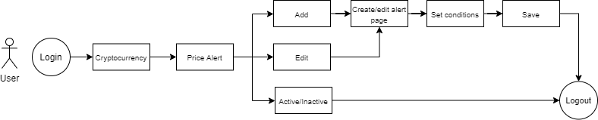
User flow

Slide 12
Acceptance Criteria
A/C 1 There will be a menu inside the cryptocurrency page called “Price Alert” A/C 2 When the user click price alert, there will be list of all the previous price alert that have been created A/C 3 User will be able to add new price alert by clicking button “Add” on the right corner of the page A/C 4 When the user click “Add” button then they will be directed to create page. The create page consist of several fields: - Token name (in which they could search the token name i.e. bitcoin, ethereum, etc that they will set price alert - Condition (condition that can be activated such as price >= or price <=) - Alert preference (set number of alert, interval time for alert, and when the alert will end) A/C 5 User will be able to save price alert and they will get alert notification based on the condition that has been set in A/C 4

Slide 13
Acceptance Criteria (continue)
Conditions: Price >= means alert will be given when the token price reach more than or equal to the inputted price Price <= means alert will be given when the token price reach less than or equal to the inputted price Alert Preference: Alert means the number of alert sent will be limited to maximum number inputted in this field Interval means the alert will be given at interval of times chosen in this field For example: Alert 1 with interval Day An alert will be sent maximum once a day if the condition met otherwise it will not send any alert End date means the alert will automatically became inactive after the date inputted in this field

Slide 14
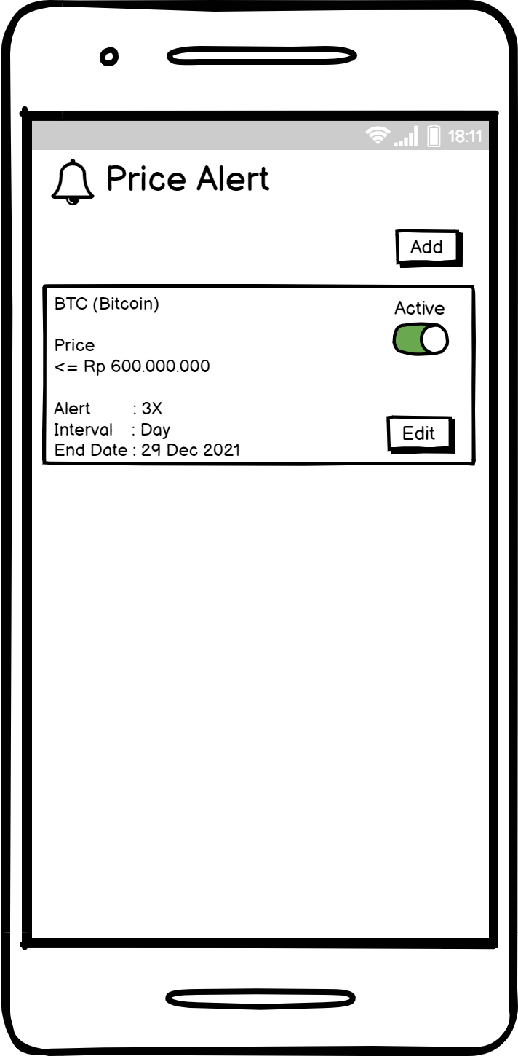
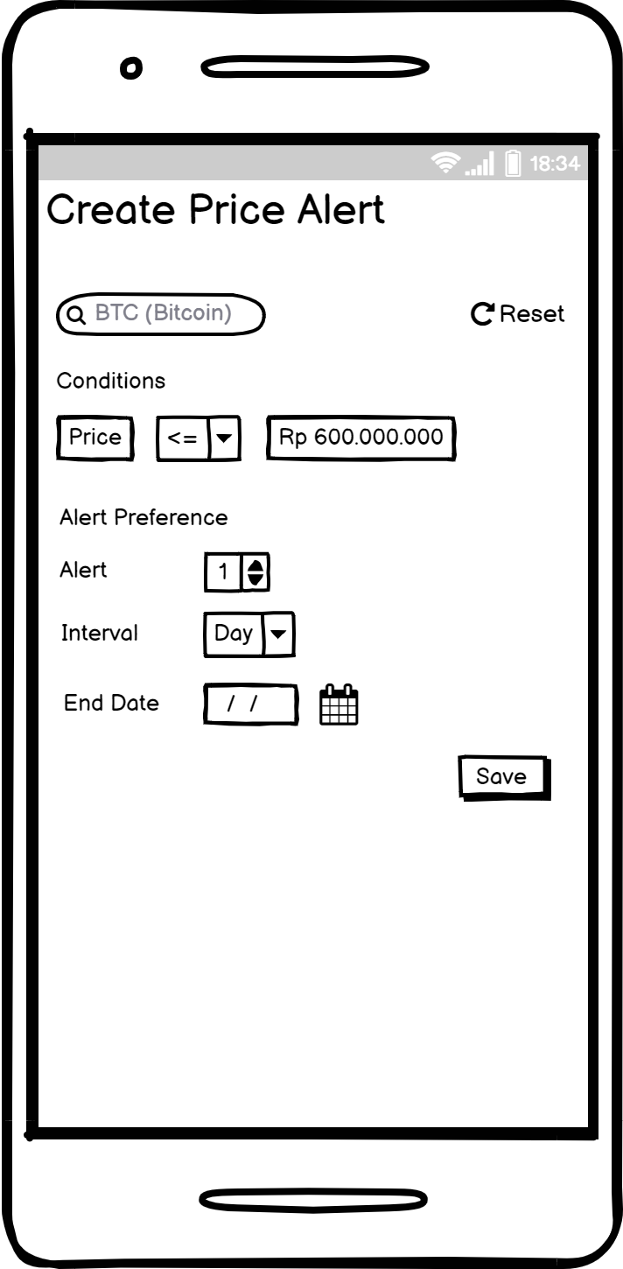
Wireframe
<- Price Alert Page
<- Create/Edit Alert Page

Slide 15
Potential Future Development
Add the conditions to alert for trade volume (idea number 2) or event (idea number 5)
Add option for quick action such as buy or sell
Automatic expire alert to reduce unused alert
Add redirect link to the token page when user click the alert notification

Slide 16
Case 5
You’ve just launched a new feature aimed at increasing trading activity on a digital investment platform.
What are the top 3 metrics you would track to evaluate the feature’s success?Please rank them from most to least important, and describe how you would measure each metric (e.g., product analytics tools like Firebase, user surveys, or interviews).

Slide 17
Answer of Case 5
Top 3 metrics:
Feature Adoption Rate FAR = (# of users who used the feature) / (total eligible users) Measured by Firebase Events, Amplitude funnels, or in-product instrumentation
Trading Volume per Active User (TVPAU) Measured by Mixpanel, Firebase, or Amplitude
User Satisfaction Score of The Feature Measured by user interview or survey after the user use the feature. Also can tools like tools like Hotjar, Typeform, or native in-app feedback.

